Slide 1

Measures of Central Tendency

Slide 2
Terminology Populations & Samples
Population: the complete set of individuals, objects or scores of interest.
  Often too large to sample in its entirety
  It may be real or hypothetical (e.g. the results from an experiment repeated ad infinitum)
Sample: A subset of the population.
  A sample may be classified as random (each member has equal chance of being selected from a population) or convenience (what’s available).
  Random selection attempts to ensure the sample is representative of the population.

Slide 3
Variables
Variables are the quantities measured in a sample.They may be classified as:
  Quantitative i.e. numerical
    Continuous (e.g. pH of a sample, patient cholesterol levels)
    Discrete (e.g. number of bacteria colonies in a culture)
  Categorical
    Nominal (e.g. gender, blood group)
    Ordinal (ranked e.g. mild, moderate or severe illness). Often ordinal variables are re-coded to be quantitative.

Slide 4
Variables
Variables can be further classified as:
  Dependent/Response. Variable of primary interest (e.g. blood pressure in an antihypertensive drug trial). Not controlled by the experimenter.
  Independent/Predictor
    called a Factor when controlled by experimenter. It is often nominal (e.g. treatment)
    Covariate when not controlled.
If the value of a variable cannot be predicted in advance then the variable is referred to as a random variable

Slide 5
Parameters & Statistics
Parameters: Quantities that describe a population characteristic. They are usually unknown and we wish to make statistical inferences about parameters. Different to perimeters.
Descriptive Statistics: Quantities and techniques used to describe a sample characteristic or illustrate the sample data e.g. mean, standard deviation, box-plot

Slide 6
Frequency Distributions
An (Empirical) Frequency Distribution or Histogram for a continuous variable presents the counts of observations grouped within pre-specified classes or groups
A Relative Frequency Distribution presents the corresponding proportions of observations within the classes
A Barchart presents the frequencies for a categorical variable

Slide 7
Two Types of Statistics
Descriptive statistics of a POPULATION
Relevant notation (Greek):
  μ mean
  N population size
  ∑ sum
Inferential statistics of SAMPLES from a population.
  Assumptions are made that the sample reflects the population in an unbiased form. Roman Notation:
  X mean
  n sample size
  ∑ sum

Slide 8
Be careful though because you may want to use inferential statistics even when you are dealing with a whole population.
Measurement error or missing data may mean that if we treated a population as complete that we may have inefficient estimates.
  It depends on the type of data and project.
  Example of Democratic Peace.

Slide 9
Also, be careful about the phrase “descriptive statistics”. It is used generically in place of measures of central tendency and dispersion for inferential statistics.
Another name is “summary statistics”, which are univariate:
  Mean, Median, Mode, Range, Standard Deviation, Variance, Min, Max, etc.

Slide 10
Measures of Central Tendency
These measures tap into the average distribution of a set of scores or values in the data.
  Mean
  Median
  Mode

Slide 11
What do you “Mean”?
The “mean” of some data is the average score or value, such as the average age of an MPA student or average weight of professors that like to eat donuts.
Inferential mean of a sample: X=(∑X)/n
Mean of a population: μ=(∑X)/N

Slide 12
Problem of being “mean”
The main problem associated with the mean value of some data is that it is sensitive to outliers.
Example, the average weight of political science professors might be affected if there was one in the department that weighed 600 pounds.

Slide 13
Donut-Eating Professors
Professor | Weight |  | Weight
Schmuggles | 165 |  | 165
Bopsey | 213 |  | 213
Pallitto | 189 |  | 410
Homer | 187 |  | 610
Schnickerson | 165 |  | 165
Levin | 148 |  | 148
Honkey-Doorey | 251 |  | 251
Zingers | 308 |  | 308
Boehmer | 151 |  | 151
Queenie | 132 |  | 132
Googles-Boop | 199 |  | 199
Calzone | 227 |  | 227
 | 194.6 |  | 248.3

Slide 14
The Median
Because the mean average can be sensitive to extreme values, the median is sometimes useful and more accurate.
The median is simply the middle value among some scores of a variable. (no standard formula for its computation)

Slide 15
What is the Median?
Professor | Weight
Schmuggles | 165
Bopsey | 213
Pallitto | 189
Homer | 187
Schnickerson | 165
Levin | 148
Honkey-Doorey | 251
Zingers | 308
Boehmer | 151
Queenie | 132
Googles-Boop | 199
Calzone | 227
 | 194.6
Weight
132
148
151
165
165
187
189
199
213
227
251
308
Rank order and choose middle value.
If even then average between two in the middle

Slide 16
Percentiles
If we know the median, then we can go up or down and rank the data as being above or below certain thresholds.
You may be familiar with standardized tests. 90th percentile, your score was higher than 90% of the rest of the sample.

Slide 17
The Mode
The most frequent response or value for a variable.
Multiple modes are possible: bimodal or multimodal.

Slide 18
Figuring the Mode
Professor | Weight
Schmuggles | 165
Bopsey | 213
Pallitto | 189
Homer | 187
Schnickerson | 165
Levin | 148
Honkey-Doorey | 251
Zingers | 308
Boehmer | 151
Queenie | 132
Googles-Boop | 199
Calzone | 227
What is the mode?
Answer: 165
Important descriptive information that may help inform your research and diagnose problems like lack of variability.

Slide 19
Measures of Dispersion (not something you cast…)
Measures of dispersion tell us about variability in the data. Also univariate.
Basic question: how much do values differ for a variable from the min to max, and distance among scores in between. We use:
  Range
  Standard Deviation
  Variance

Slide 20
Remember that we said in order to glean information from data, i.e. to make an inference, we need to see variability in our variables.
Measures of dispersion give us information about how much our variables vary from the mean, because if they don’t it makes it difficult infer anything from the data. Dispersion is also known as the spread or range of variability.

Slide 21
The Range
r = h – l
  Where h is high and l is low
In other words, the range gives us the value between the minimum and maximum values of a variable.
Understanding this statistic is important in understanding your data, especially for management and diagnostic purposes.

Slide 22
The Standard Deviation
A standardized measure of distance from the mean.
Very useful and something you do read about when making predictions or other statements about the data.

Slide 23
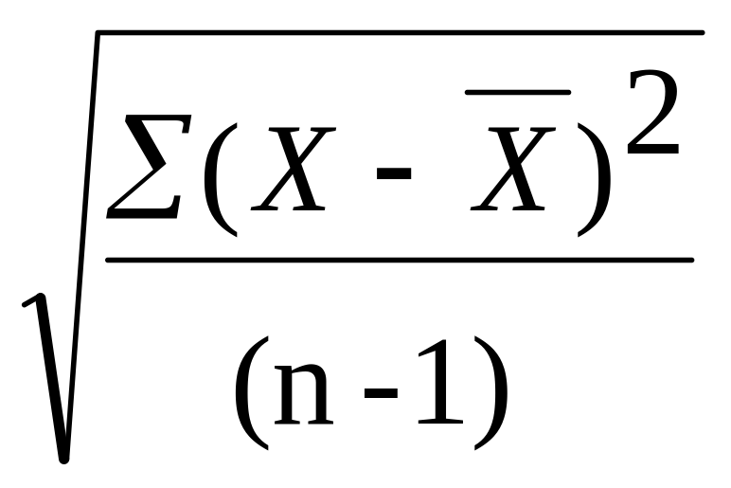
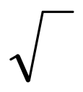
Formula for Standard Deviation
S =
=square root
∑=sum (sigma)
X=score for each point in data
_
X=mean of scores for the variable
n=sample size (number of observations or cases

Slide 24
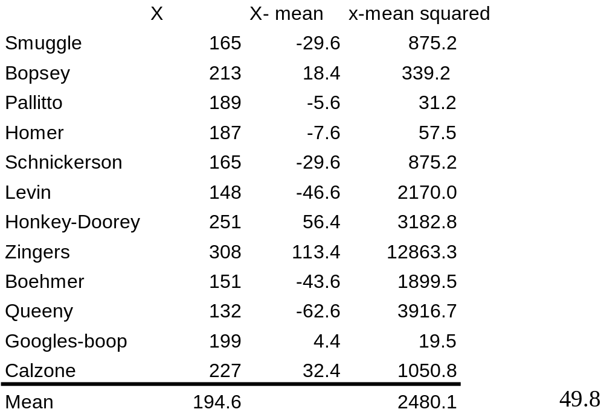
We can see that the Standard Deviation equals 165.2 pounds. The weight of Zinger is still likely skewing this calculation (indirectly through the mean).

Slide 25
Example of S in use
Boehmer- Sobek paper.
  One standard deviation increase in the value of X variable increases the Probability of Y occurring by some amount.

Slide 26
Table 2: Development and Relative Risk of Territorial Claim
Probability*
% Change
Baseline
0.0401
development
0.0024
-94.3
pop density
0.0332
-17.3
pop growth
0.0469
16.8
Capability
0.0813
102.5
Openness
0.0393
-2
Capability and pop growth
0.0942
134.8
% Change in prob after 1 sd change in given x variable, holding others at their means

Slide 27
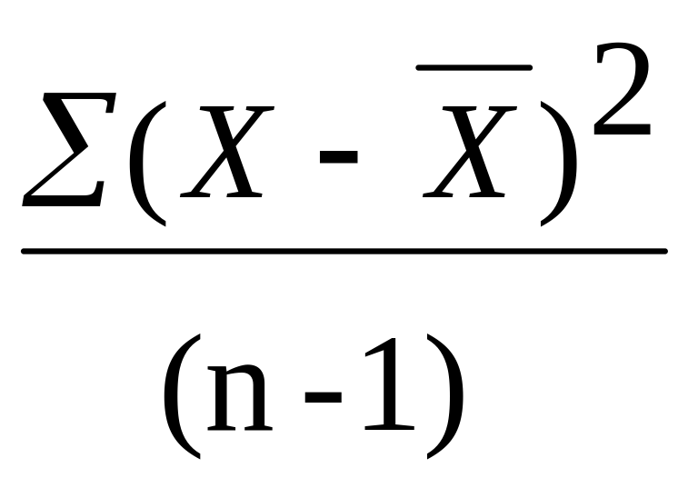
Variance
=
Note that this is the same equation except for no square root taken.
Its use is not often directly reported in research but instead is a building block for other statistical methods

Slide 28

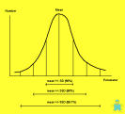




Slide 29
Goal of Graphing?
Presentation of Descriptive Statistics
Presentation of Evidence
Some people understand subject matter better with visual aids
Provide a sense of the underlying data generating process (scatter-plots)

Slide 30
What is the Distribution?
Gives us a picture of the variability and central tendency.
Can also show the amount of skewness and Kurtosis.

Slide 31
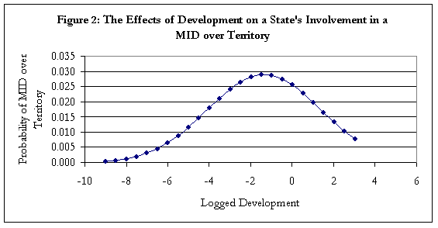
Graphing Data: Types

Slide 32
Creating Frequencies
We create frequencies by sorting data by value or category and then summing the cases that fall into those values.
How often do certain scores occur? This is a basic descriptive data question.

Slide 33
Ranking of Donut-eating Profs. (most to least)
Zingers | 308
Honkey-Doorey | 251
Calzone | 227
Bopsey | 213
Googles-boop | 199
Pallitto | 189
Homer | 187
Schnickerson | 165
Smuggle | 165
Boehmer | 151
Levin | 148
Queeny | 132

Slide 34
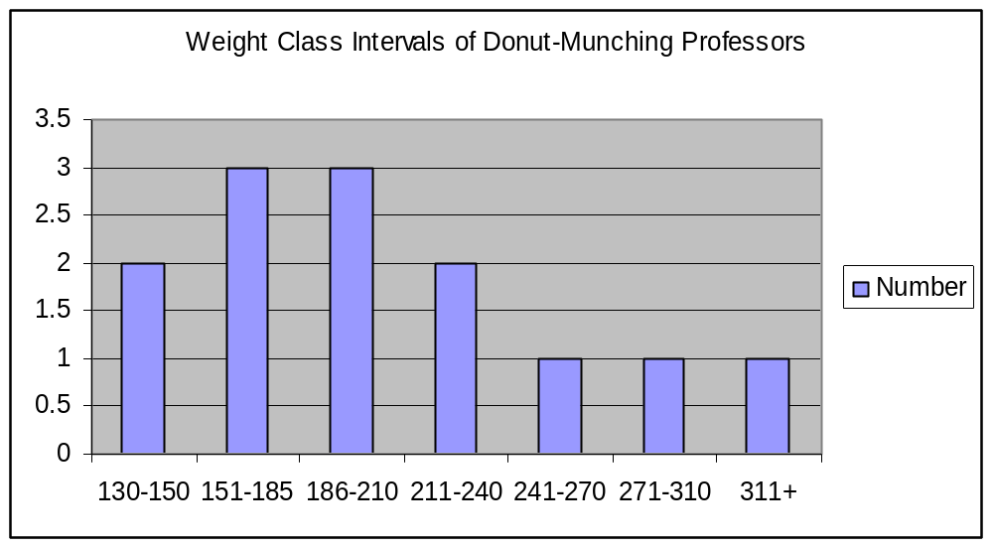
Here we have placed the Professors into weight classes and depict with a histogram in columns.

Slide 35
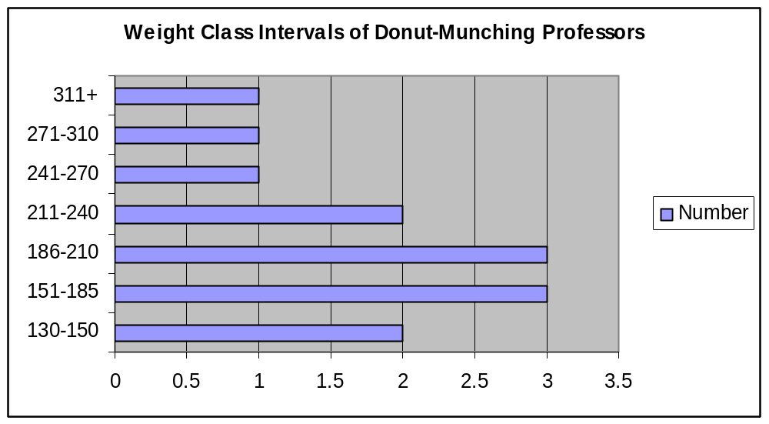
Here it is another histogram depicted as a bar graph.

Slide 36
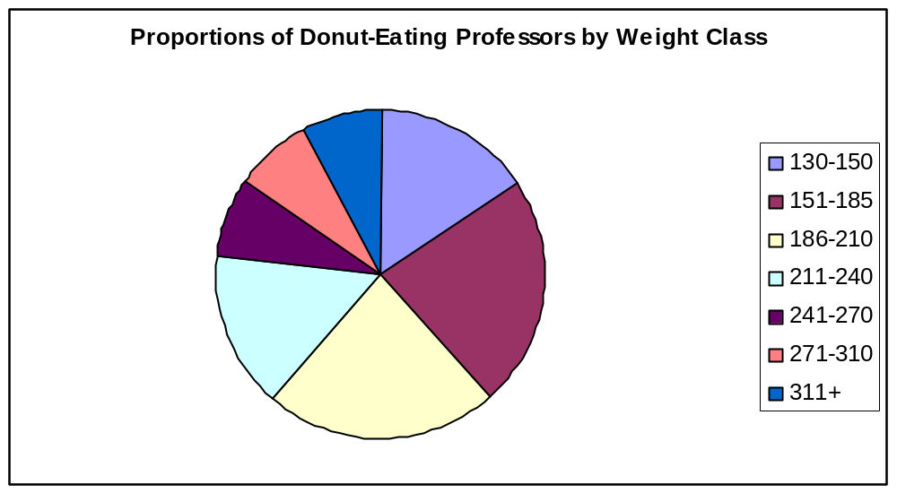
Pie Charts:

Slide 37
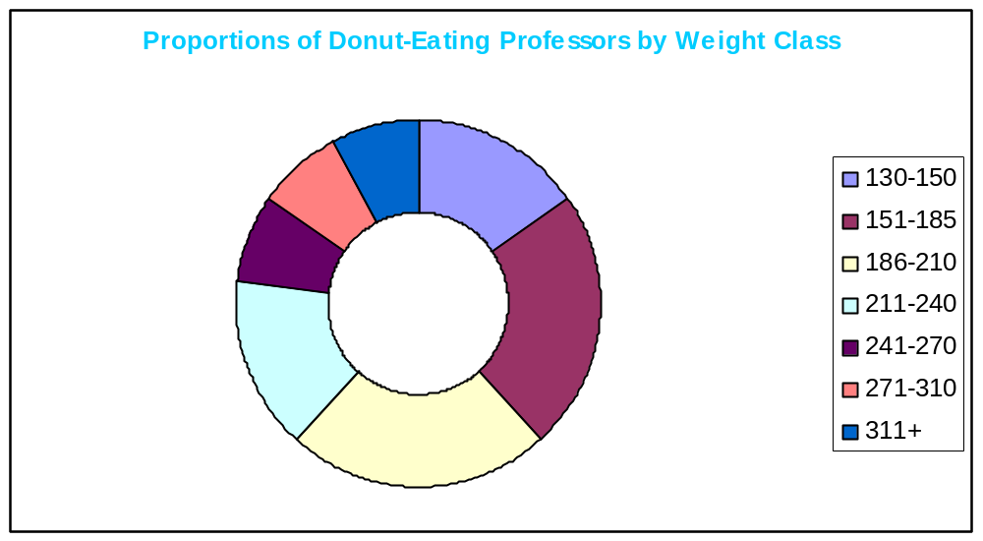
Actually, why not use a donut graph. Duh!
See Excel for other options!!!!

Slide 38
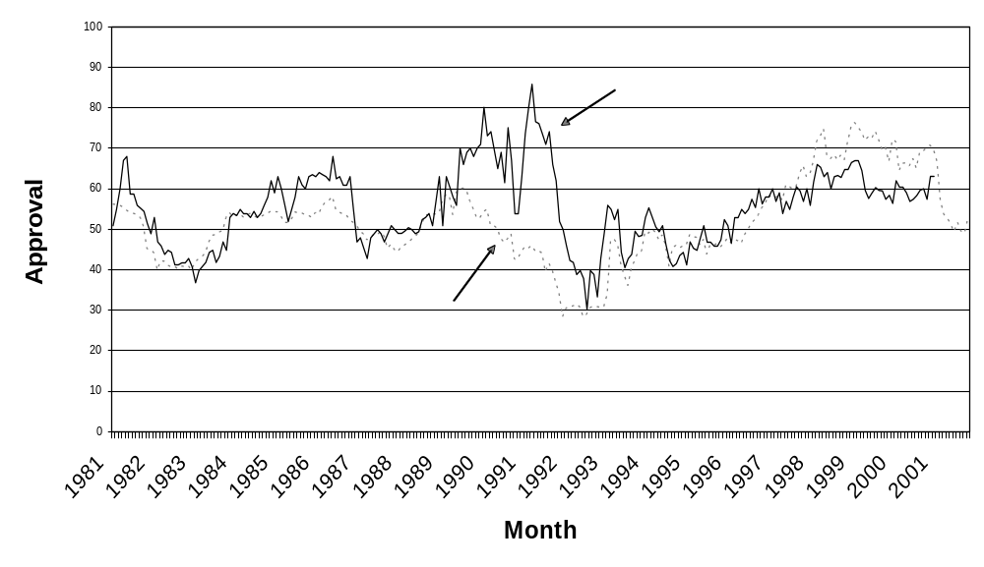
Line Graphs: A Time Series

Slide 39
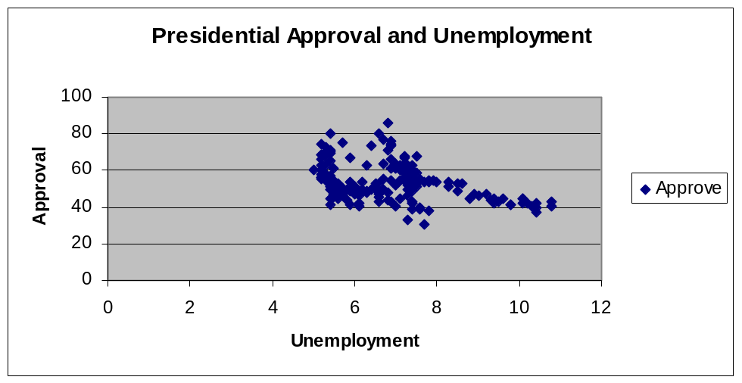
Scatter Plot (Two variable)

